Slide 1
Project 4: Collaborative Filtering
Group 6 Members:
Chandak, Anshuma
He, Shan
Li, Hongyu
Liu, Shiyu
Zhang, Junkai (Presenter)
Notes:
it’s my pleasure to give the presentation
In this project, we used memory-based algorithm and model-based algorithm to do collaborative filtering.

Slide 2

Agenda
Data Processing
Memory Based Algorithm
Model Based Algorithm
Result Analysis
Notes:
The goal of this project is to implement 2 types of collaborative filtering algorithms and compare the different model options. For memory-based algorithm, we use combination of different similarities and different neighbors methods to do collaborative filtering.
We use cluster model as model-based algorithm, in which all users are separated into groups(by their preferences) and the estimation of user’s preference towards new item based on Bayes formulation.

Slide 3
Data Processing
Rearrange the MS dataset by setting rows to users and columns to items. Assign 0 to those items which are not clicked by users
Rearrange the EachMovie dataset by setting rows to users and columns to movies. Assign NA to those movies which are not rated by users

Slide 4
Memory Based Algorithm
Similarity Weighting
Spearman Correlation(1,2)
Variance Weighting
No
Selecting Neighbors
Weight Threshold
Evaluation
Mean Square Difference(1,2)
SimRank(1)
Best-n-estimator
Combined
Rank Score(1)
Mean Absolute Error(2)

Slide 5
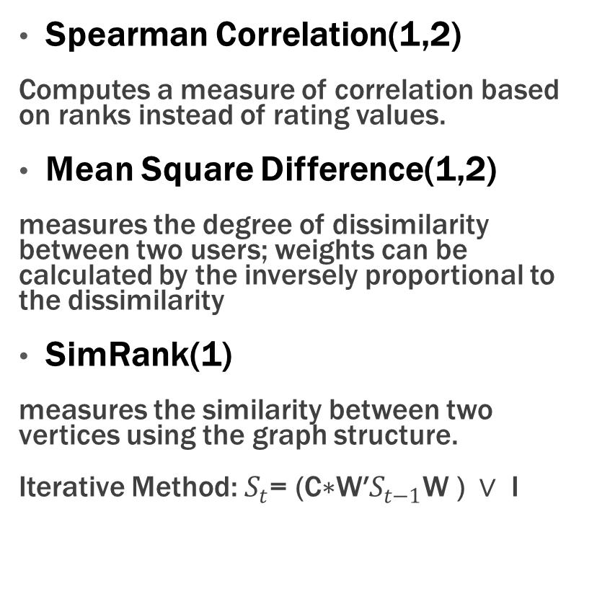
Similarity Weight
Similarity Mean (exclude diagonal elements)
 | MS Data | Movie Data
Spearman Correlation | 0.313107 | 0.2228353
Mean-square-difference | 0.252741 | 0.2076056
SimRank(c=0.8,k=5) | 0.049101 | 0.00366881
Spearman Correlation(1,2)
Computes a measure of correlation based on ranks instead of rating values.
Mean Square Difference(1,2)
measures the degree of dissimilarity between two users; weights can be calculated by the inversely proportional to the dissimilarity
SimRank(1)
measures the similarity between two vertices using the graph structure.
Iterative Method: $S_{t}\text{= (}\text{C}\text{∗}\text{W}\text{′}S_{t−1}\text{W}\text{ ) }∨ \text{I}$

Slide 6
Selecting Neighbors
Weight Threshold
All the neighbors with absolute correlations greater than a given threshold are selected.
Best-n-estimator
Picks the best n correlates for a given n.
Combined
Sets the best n and threshold together.
Notes:
Higher threshold results in a lower coverage. A lower correlation threshold nullifying the purpose of thresholding.
2nd method performs reasonably better, as it doesn’t limit the prediction coverage.
Combined method doesn’t result in a significant improvement over best n. (cuz there is little difference between extremely low correlates and moderately low correlates)

Slide 7
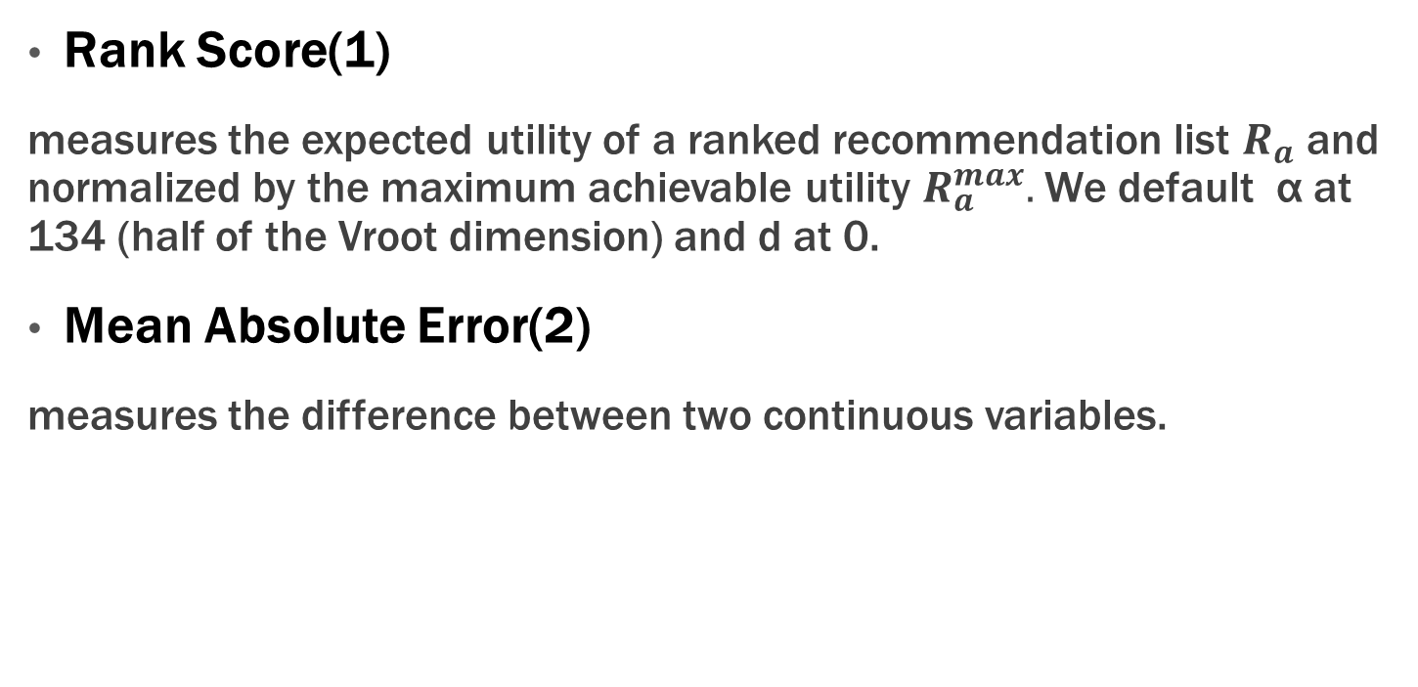
Evaluation
Rank Score(1)
measures the expected utility of a ranked recommendation list $R_{a}$ and normalized by the maximum achievable utility $R_{a}^{max}.$ We default α at 134 (half of the Vroot dimension) and d at 0.
Mean Absolute Error(2)
measures the difference between two continuous variables.

Slide 8
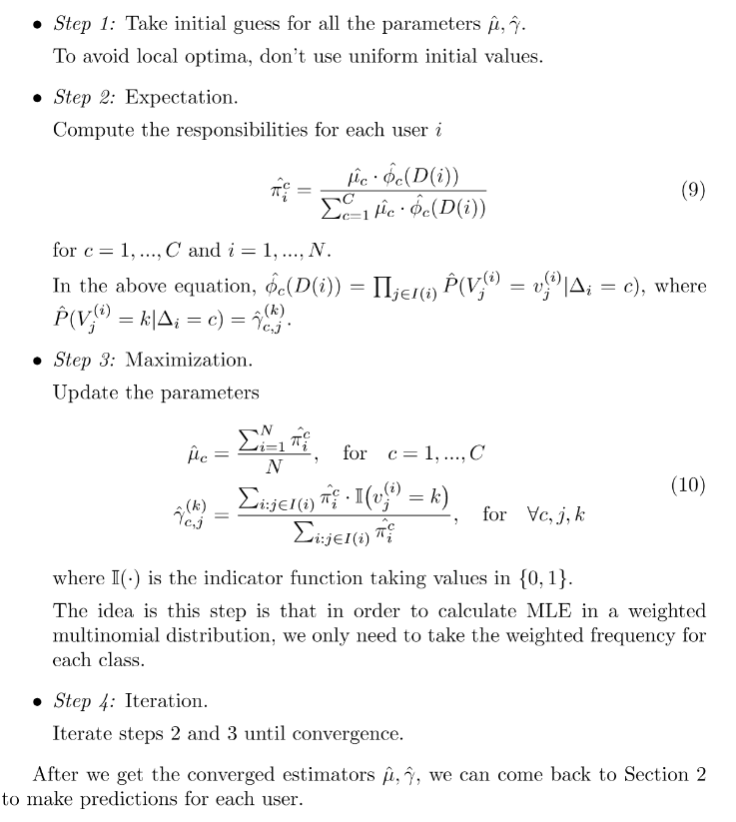
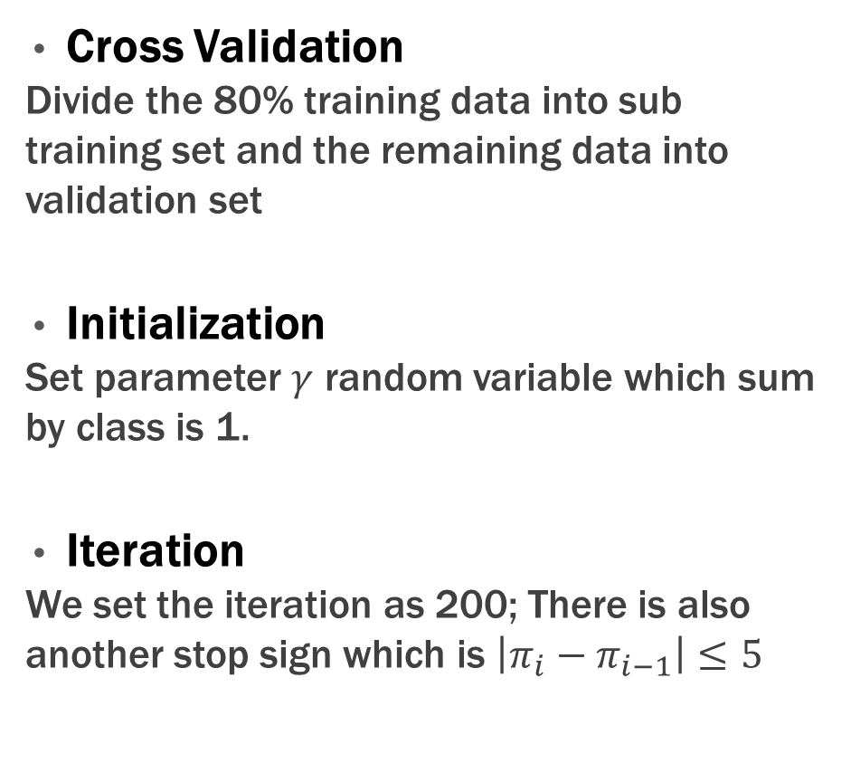
Model Based Algorithm – Multinomial EM Algorithm
Cross Validation
Divide the 80% training data into sub training set and the remaining data into validation set
Initialization
Set parameter $γ$ random variable which sum by class is 1.
Iteration
We set the iteration as 200; There is also another stop sign which is $\left|π_{i}−π_{i−1}\right|≤5$

Slide 9
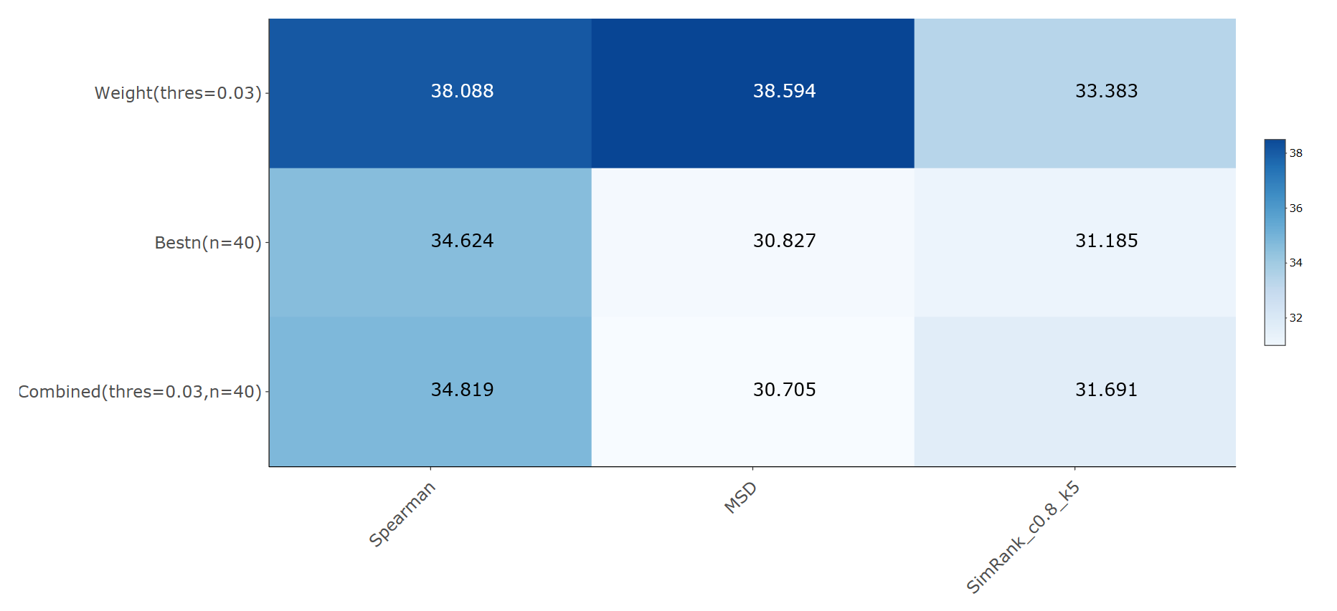

Memory Based Model (Microsoft Data)

Slide 10
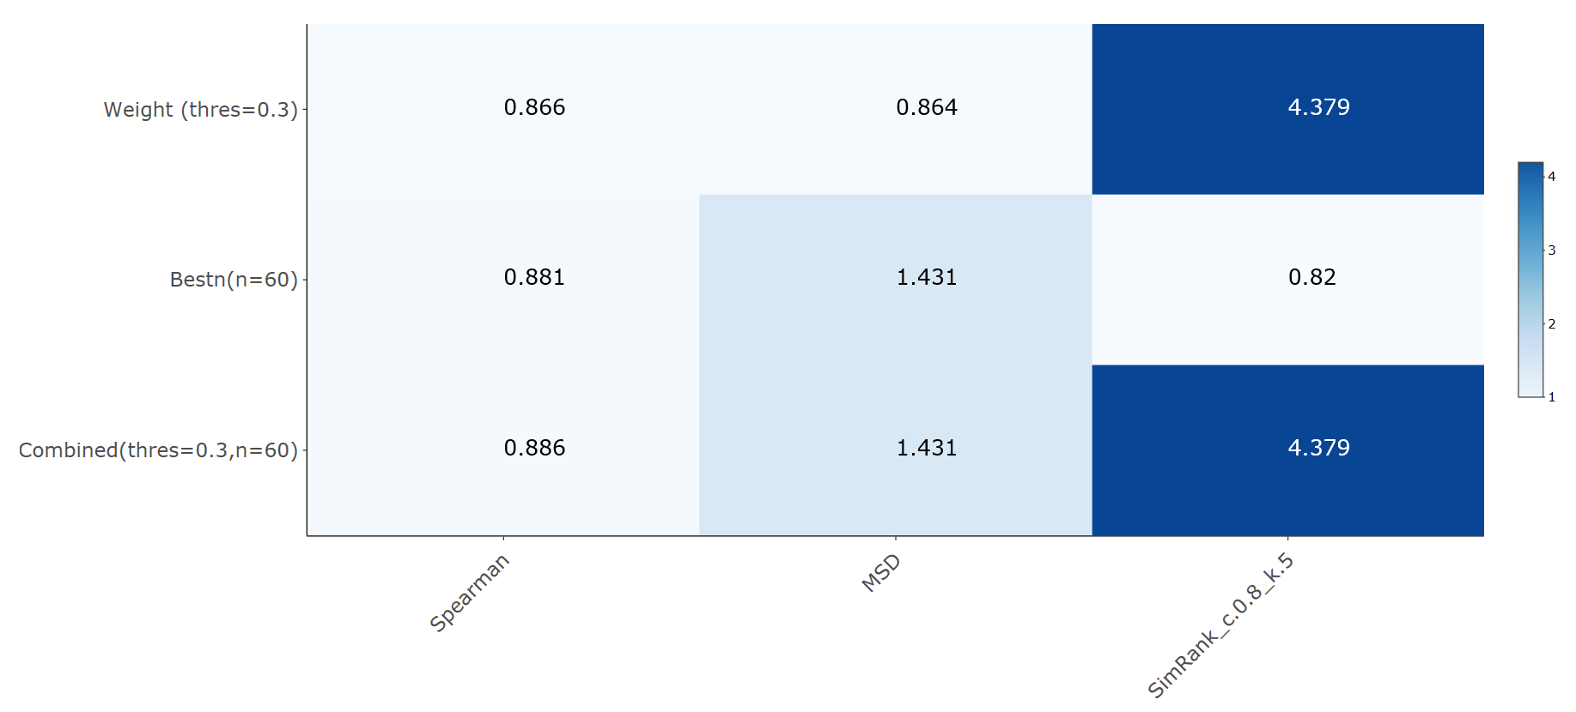
Memory Based Model (EachMovie Data)

Slide 11
Result Analysis
MS Data | Spearman Correlation | Mean-square-difference | SimRank (c=0.8,k=5)
Weight Threshold (threshold=0.03) | 38.08806 | 38.59387 | 33.38262
Best-n-estimator (n=40) | 34.624 | 30.82725 | 31.18457
Combined (thres=0.03,n=40) | 34.81887 | 30.70532 | 31.69077
EachMovie Data | Spearman Correlation | Mean-square-difference | SimRank (c=0.8,k=5)
Weight Threshold (threshold=0.3) | 0.866422 | 0.864105 | 4.379151
Best-n-estimator (n=60) | 0.881227 | 1.430936 | 0.820144
Combined (thres=0.3,n=60) | 0.885659 | 1.430936 | 4.379151
Comparison of Three Weights
For the Microsoft data, the Spearman correlation performs better than mean square different and SimRank based on the best n neighbors.
For the EachMovie data, SimRank outperforms than the other two methods.
Notes:
Reason: there are more choices to establish similarity when it comes to Movie Data given the range of vote is 1 to 6.

Slide 12
Result Analysis
MS Data | Spearman Correlation | Mean-square-difference | SimRank (c=0.8,k=5)
Weight Threshold (threshold=0.03) | 38.08806 | 38.59387 | 33.38262
Best-n-estimator (n=40) | 34.624 | 30.82725 | 31.18457
Combined (thres=0.03,n=40) | 34.81887 | 30.70532 | 31.69077
EachMovie Data | Spearman Correlation | Mean-square-difference | SimRank (c=0.8,k=5)
Weight Threshold (threshold=0.3) | 0.866422 | 0.864105 | 4.379151
Best-n-estimator (n=60) | 0.881227 | 1.430936 | 0.820144
Combined (thres=0.3,n=60) | 0.885659 | 1.430936 | 4.379151
Comparison of Three Neighbors Selections
A Higher threshold results in a lower coverage. A lower correlation threshold nullifies the purpose of thresholding.
The advantage of second method is that it doesn’t limit the prediction coverage.
The performance of combined method closes to the worse performance of above two methods.

Slide 13
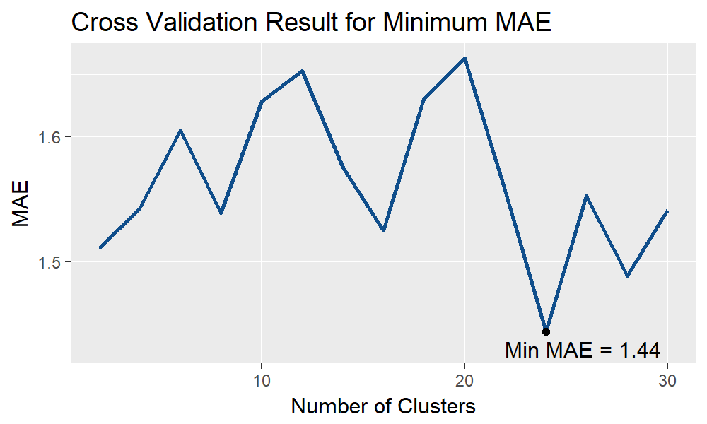
Result Analysis
Compare Memory-based and Model-based algorithm
MAE of cluster model with 24 clusters is 1.44
Higher than the best performance of our Memory-based model.
Notes:
the cluster model divides users into diff groups, and it gives the make the predictions based on the grouped result, not based on each user’s information. MBM gives the personalized prediction based on each user’s information.

Slide 14
SimRank Analysis
 | SimRank (c=0.8,k=5) | SimRank (c=0.6,k=5) | SimRank (c=0.8,k=10)
Weight Threshold(threshold=0.03) | 33.38262 | 30.67534 | 36.49933
Best-n-estimator(n=40) | 31.18457 | 31.12883 | 31.19928
Combined(threshold=0.03,n=40) | 31.69077 | 31.48125 | 31.08686
For the iterations, larger K performs slight better than K=5.
For the damping factor, smaller C value performs worse than C=0.8.

Slide 15
Reference
Thank you!
Breese, J. S., Heckerman, D., & Kadie, C. (1998, July). Empirical analysis of predictive algorithms From Microsoft Research. It is an introduction to collaborative filtering, and evaluated the data set we use.
Herlocker, J. L., Konstan, J. A., Borchers, A., & Riedl, J. (1999, August). An algorithmic framework for performing collaborative filtering. In Proceedings of the 22nd annual international ACM SIGIR conference on Research and development in information retrieval (pp. 230-237). ACM.
Jeh, G., & Widom, J. (2002, July). SimRank: a measure of structural-context similarity. In Proceedings of the eighth ACM SIGKDD international conference on Knowledge discovery and data mining (pp. 538-543). ACM.

